Slide 1
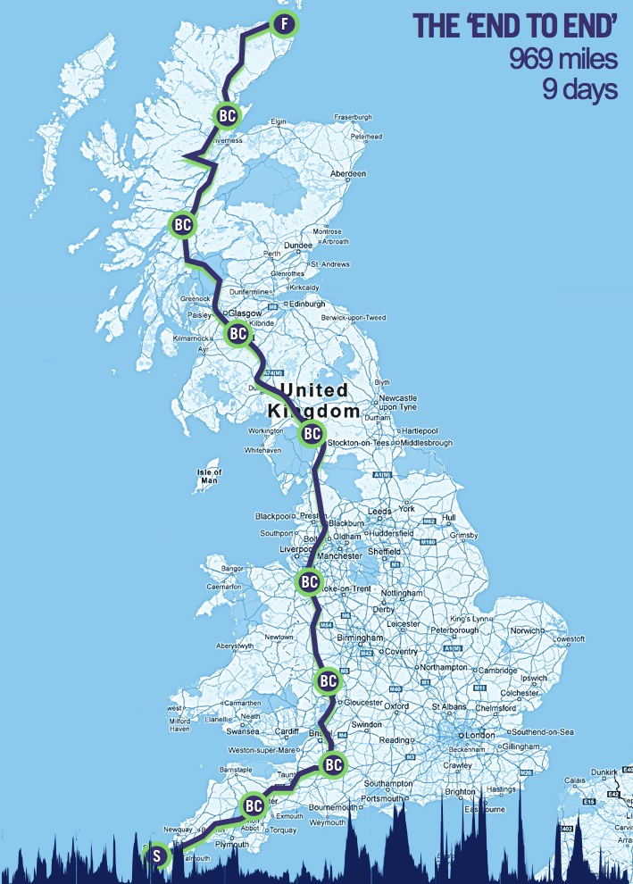
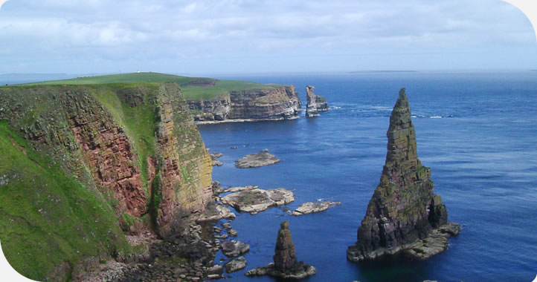
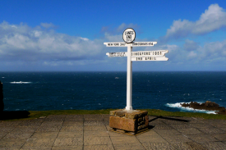
Please Sponsor Me!
I’m riding the iconic Deloitte Ride across Britain, Lands End to John O’Groats from 5th to 14th September for St Barnabas Hospice and Bowel Diseases Research Foundation:
969 miles, 56000ft climbing in 9 days, sleeping in a tent!
Help motivate me through wind and rain by sponsoring me at
https://www.justgiving.com/malcolm-mcfall1/ for BDRF or
https://www.justgiving.com/malcolmmcfall/ for St Barnabas
Thank-you!
Malcolm McFall, Consultant Colorectal Surgeon, West Sussex Hospitals.

